Slide 1
Classification Algorithms –
Rules

Slide 2
Outline
Generating Rules
The Covering Algorithm
Rules VS Decision Lists

Slide 3
Generating Rules
Decision tree can be converted into a rule set
Straightforward conversion:
  each path to the leaf becomes a rule – makes an overly complex rule set
More effective conversions are not trivial
  (e.g. C4.8 tests each node in root-leaf path to see if it can be eliminated without loss in accuracy)
Notes:
In the previous lesson we discussed Classification using decision trees.
Sometimes decision trees are inconvenient – they can be very large
Also, they require starting at the same attribute
We can extract modular “nuggets” of knowledge by getting rules

Slide 4
Covering algorithms
Strategy for generating a rule set directly: for each class in turn find rule set that covers all instances in it (excluding instances not in the class)
This approach is called a covering approach because at each stage a rule is identified that covers some of the instances

Slide 5
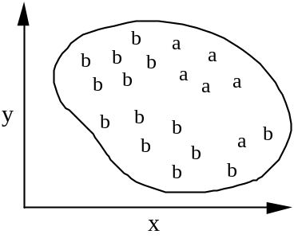
Example: generating a rule
If true then class = a

Slide 6
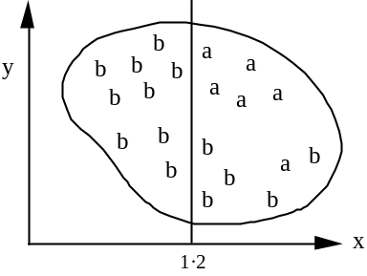
Example: generating a rule, II
If true then class = a
If x > 1.2 then class = a
Notes:
We now split along X axis and most of the cases on

Slide 7
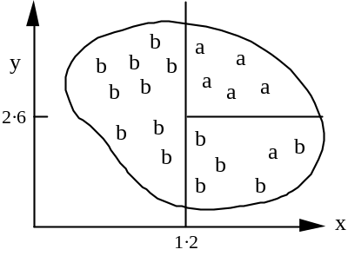
Example: generating a rule, III
If true then class = a
If x > 1.2 and y > 2.6 then class = a
If x > 1.2 then class = a

Slide 8
Example: generating a rule, IV
If true then class = a
If x > 1.2 and y > 2.6 then class = a
If x > 1.2 then class = a
Possible rule set for class “b”:
More rules could be added for “perfect” rule set
If x ≤ 1.2 then class = b If x > 1.2 and y ≤ 2.6 then class = b

Slide 9
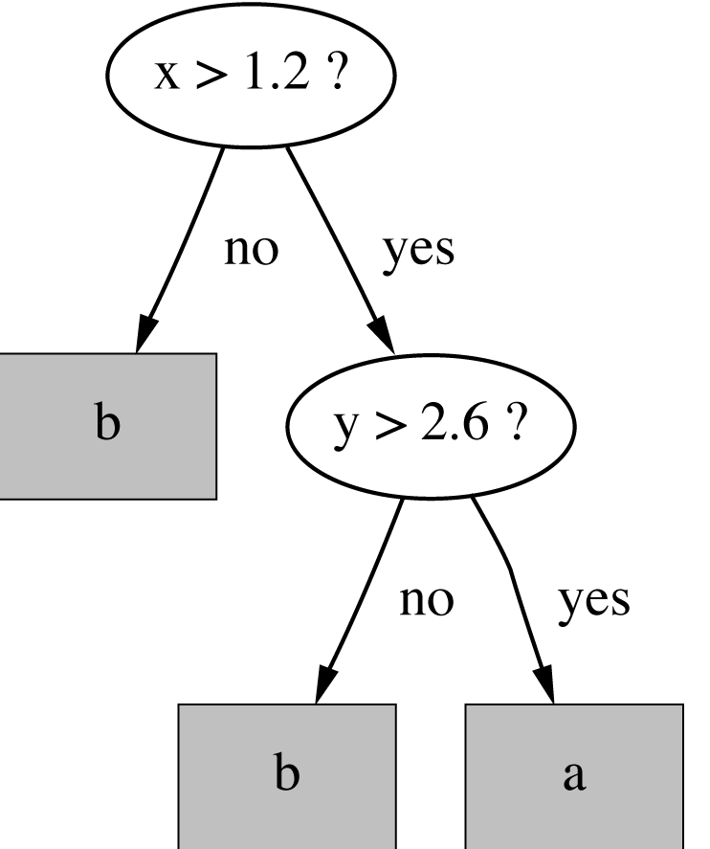
Rules vs. trees
Corresponding decision tree:
(produces exactly the same
predictions)
But: rule sets can be more clear when decision trees suffer from replicated subtrees
Also: in multi-class situations, covering algorithm concentrates on one class at a time whereas decision tree learner takes all classes into account

Slide 10
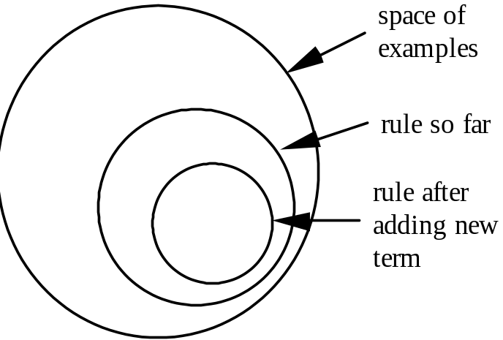
A simple covering algorithm
Generates a rule by adding tests that maximize rule’s accuracy
Similar to situation in decision trees: problem of selecting an attribute to split on
  But: decision tree inducer maximizes overall purity
Each new test reduces
rule’s coverage:

Slide 11
Selecting a test
Goal: maximize accuracy
  t total number of instances covered by rule
  p positive examples of the class covered by rule
  t – p number of errors made by rule
  Select test that maximizes the ratio p/t
We are finished when p/t = 1 or the set of instances can’t be split any further

Slide 12
Example: contact lens data, 1
If ? then recommendation = hard
Rule we seek:
Possible tests:
Age = Young | 2/8
Age = Pre-presbyopic
Age = Presbyopic
Spectacle prescription = Myope
Spectacle prescription = Hypermetrope
Astigmatism = no
Astigmatism = yes
Tear production rate = Reduced
Tear production rate = Normal

Slide 13
Example: contact lens data, 2
If ? then recommendation = hard
Rule we seek:
Possible tests:
Age = Young | 2/8
Age = Pre-presbyopic | 1/8
Age = Presbyopic | 1/8
Spectacle prescription = Myope | 3/12
Spectacle prescription = Hypermetrope | 1/12
Astigmatism = no | 0/12
Astigmatism = yes | 4/12
Tear production rate = Reduced | 0/12
Tear production rate = Normal | 4/12

Slide 14
Modified rule and resulting data
Rule with best test added:
Instances covered by modified rule:
If astigmatism = yes then recommendation = hard
Age | Spectacle prescription | Astigmatism | Tear production rate | Recommended lenses
Young | Myope | Yes | Reduced | None
Young | Myope | Yes | Normal | Hard
Young | Hypermetrope | Yes | Reduced | None
Young | Hypermetrope | Yes | Normal | hard
Pre-presbyopic | Myope | Yes | Reduced | None
Pre-presbyopic | Myope | Yes | Normal | Hard
Pre-presbyopic | Hypermetrope | Yes | Reduced | None
Pre-presbyopic | Hypermetrope | Yes | Normal | None
Presbyopic | Myope | Yes | Reduced | None
Presbyopic | Myope | Yes | Normal | Hard
Presbyopic | Hypermetrope | Yes | Reduced | None
Presbyopic | Hypermetrope | Yes | Normal | None

Slide 15
Further refinement, 1
If astigmatism = yes and ? then recommendation = hard
Current state:
Possible tests:
Age = Young | 2/4
Age = Pre-presbyopic
Age = Presbyopic
Spectacle prescription = Myope
Spectacle prescription = Hypermetrope
Tear production rate = Reduced
Tear production rate = Normal

Slide 16
Further refinement, 2
If astigmatism = yes and ? then recommendation = hard
Current state:
Possible tests:
Age = Young | 2/4
Age = Pre-presbyopic | 1/4
Age = Presbyopic | 1/4
Spectacle prescription = Myope | 3/6
Spectacle prescription = Hypermetrope | 1/6
Tear production rate = Reduced | 0/6
Tear production rate = Normal | 4/6

Slide 17
Modified rule and resulting data
Rule with best test added:
Instances covered by modified rule:
If astigmatism = yes and tear production rate = normal then recommendation = hard
Age | Spectacle prescription | Astigmatism | Tear production rate | Recommended lenses
Young | Myope | Yes | Normal | Hard
Young | Hypermetrope | Yes | Normal | hard
Pre-presbyopic | Myope | Yes | Normal | Hard
Pre-presbyopic | Hypermetrope | Yes | Normal | None
Presbyopic | Myope | Yes | Normal | Hard
Presbyopic | Hypermetrope | Yes | Normal | None

Slide 18
Further refinement, 3
Current state:
Possible tests:
If astigmatism = yes and tear production rate = normal and ? then recommendation = hard
Age = Young
Age = Pre-presbyopic
Age = Presbyopic
Spectacle prescription = Myope
Spectacle prescription = Hypermetrope

Slide 19
Further refinement, 4
Current state:
Possible tests:
Tie between the first and the fourth test
  We choose the one with greater coverage
If astigmatism = yes and tear production rate = normal and ? then recommendation = hard
Age = Young | 2/2
Age = Pre-presbyopic | 1/2
Age = Presbyopic | 1/2
Spectacle prescription = Myope | 3/3
Spectacle prescription = Hypermetrope | 1/3

Slide 20
The result
If astigmatism = yes and tear production rate = normal and spectacle prescription = myope then recommendation = hard
Final rule:
Second rule for recommending “hard lenses”:
(built from instances not covered by first rule)
These two rules cover all “hard lenses”:
  Process is repeated with other two classes
If age = young and astigmatism = yes and tear production rate = normal then recommendation = hard

Slide 21
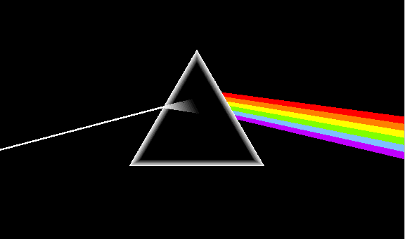
Pseudo-code for PRISM
For each class C Initialize E to the instance set While E contains instances in class C Create a rule R with an empty left-hand side that predicts class C Until R is perfect (or there are no more attributes to use) do For each attribute A not mentioned in R, and each value v, Consider adding the condition A = v to the left-hand side of R Select A and v to maximize the accuracy p/t (break ties by choosing the condition with the largest p) Add A = v to R Remove the instances covered by R from E

Slide 22
Rules vs. decision lists
PRISM with outer loop removed generates a decision list for one class
  Subsequent rules are designed for rules that are not covered by previous rules
  But: order doesn’t matter because all rules predict the same class
Outer loop considers all classes separately
  No order dependence implied
Problems: overlapping rules, default rule required

Slide 23
Separate and conquer
Methods like PRISM (for dealing with one class) are separate-and-conquer algorithms:
  First, a rule is identified
  Then, all instances covered by the rule are separated out
  Finally, the remaining instances are “conquered”
Difference to divide-and-conquer methods:
  Subset covered by rule doesn’t need to be explored any further

Slide 24
Conclusions
Basically, two ways of learning decision rules:
  from decision trees (straightforward, more effectively)
  directly from data
The covering approach
The PRISM algorithm
Decision rules vs. Decision lists

